Slide 1

Check (mate) vulnerabilities! Sebastián Revuelta
Some reflections about OWASP TOP 10 and chess game

Slide 2
Who am I?
Sebastian Revuelta
Security Engineer at Thales Alenia Space
More than 15 years working in software security (and quality)
Application Security: DevSecOps | SAST | SCA
Blog: securingsoftware.blog
Chess player in my childhood
sebastianrevuelta@gmail.com
https://www.linkedin.com/in/sebasrevuelta/

Slide 3
Agenda
Threats in application security
Owasp top 10
Playing vulnerable chess game
SQL Injection
Path Traversal
Cross site scripting
HTTP Response Splitting
Deep code to win the match

Slide 4
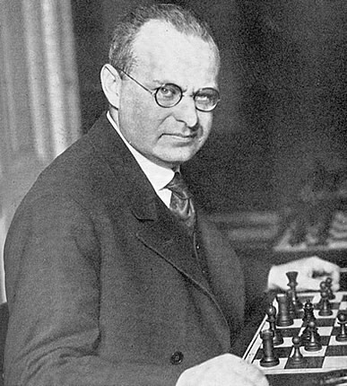
Threats
"The threat is stronger than the execution“ Aaron Nimzowitch (Latvia 1886, chess grandmaster).
We need to keep the tension and do our best all the time to avoid vulnerable points in our system.
Every move should be done to avoid risky points.

Slide 5
Threats
Can we guess/predict threats for our app?
As in a chess game we need to predict the next move of the other player (hacker?).
In software, it happens the same, we need to predict what are the possible threats that can affect our systems.
Threat modeling is like brainstorming of possible moves a hacker can do against our system.
There are different methodologies to follow: STRIDE, CAPEC, Attack Tree, OWASP TOP 10 …

Slide 6
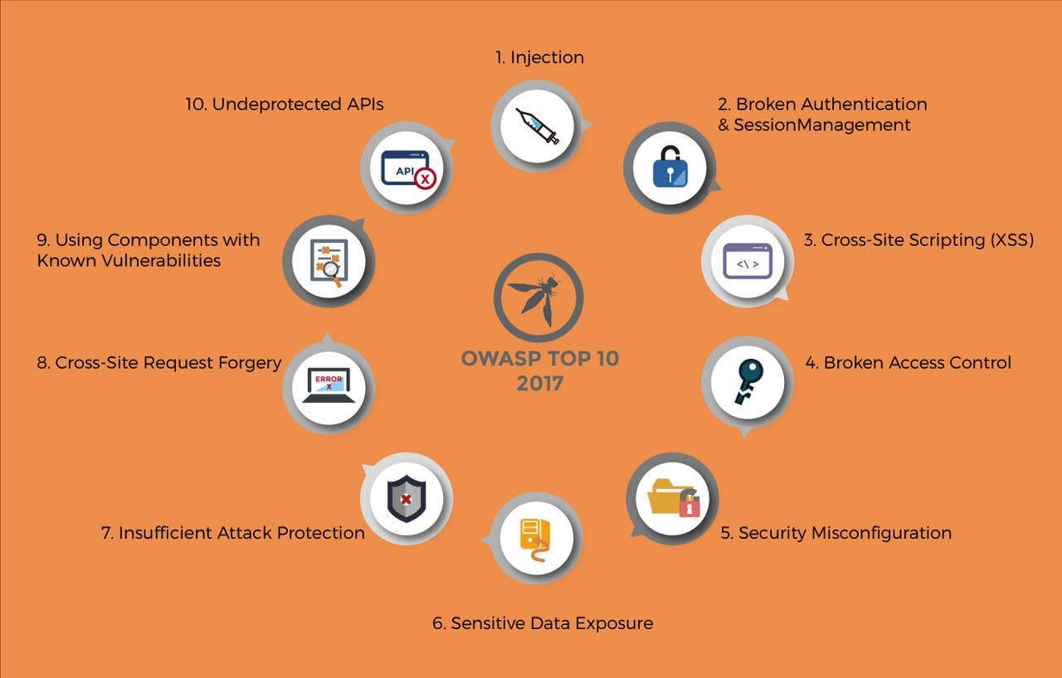
Owasp top 10

Slide 7
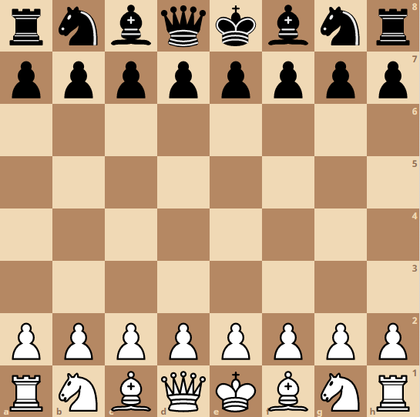
SQL Injection

Slide 8
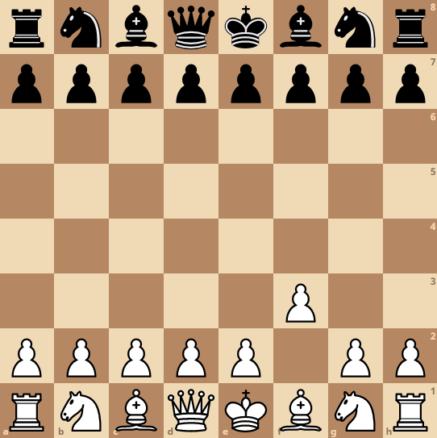
SQL Injection

Slide 9
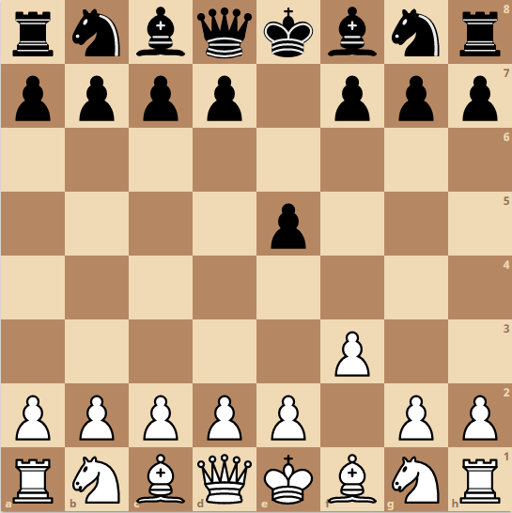
SQL Injection

Slide 10
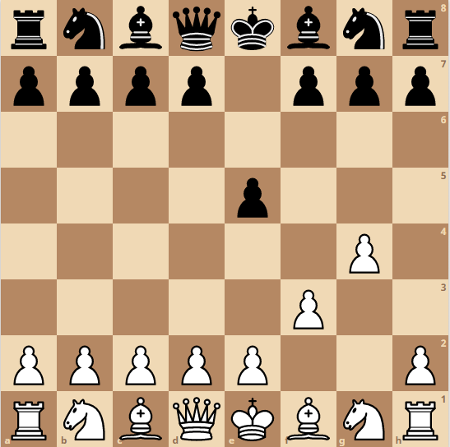
SQL Injection

Slide 11
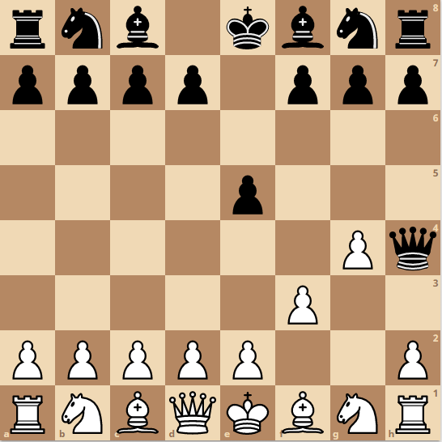
SQL Injection

Slide 12
SQL Injection

Slide 13
SQL Injection
If we don’t control all the access paths from our enemy lines to our systems. Then it can be the way to allow threats and then damage in our kingdom.
Front End
Business Logic
BBDD

Slide 14
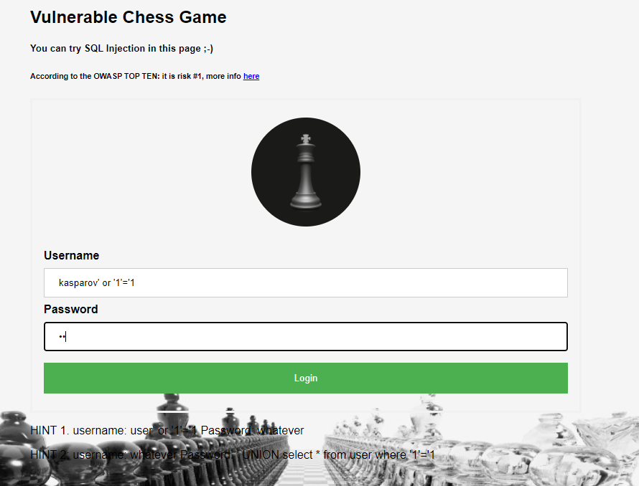
SQL Injection

Slide 15
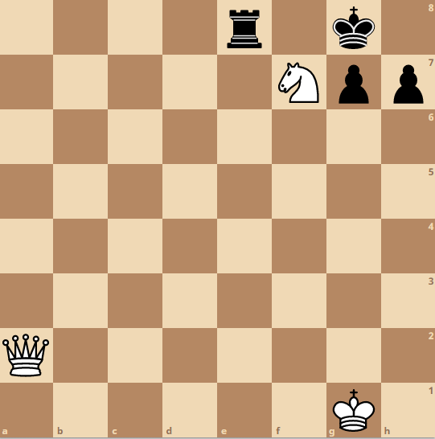
Cross site scripting

Slide 16
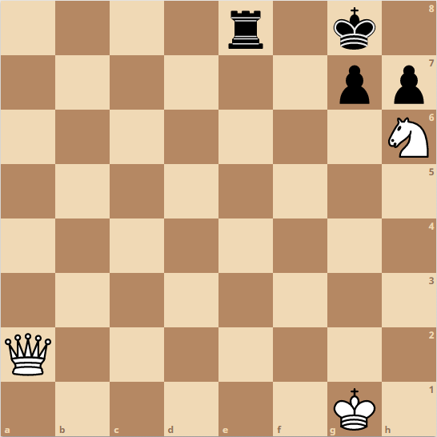
Cross site scripting

Slide 17
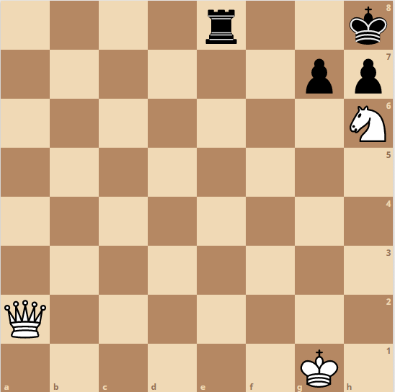
Cross site scripting

Slide 18
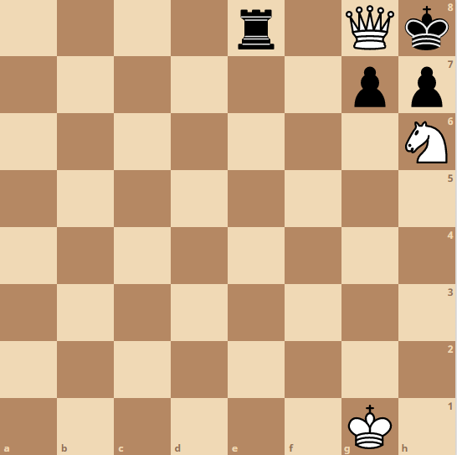
Cross site scripting

Slide 19
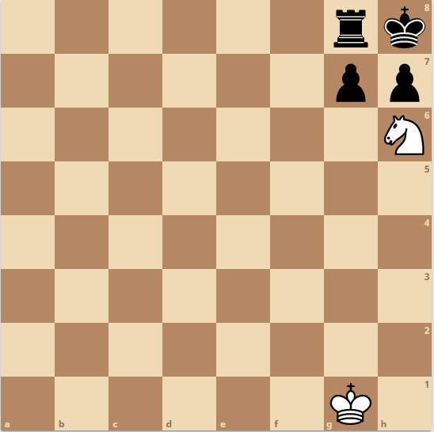
Cross site scripting

Slide 20
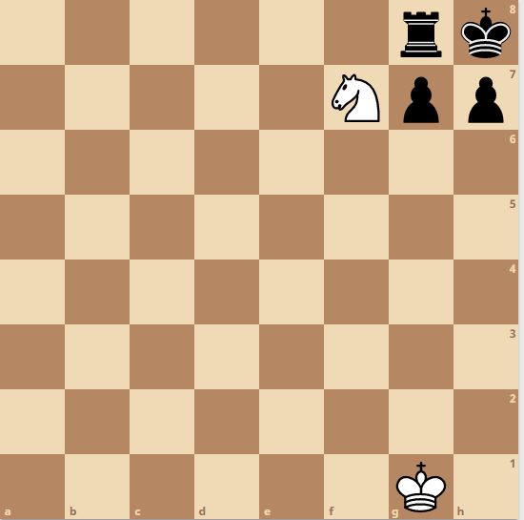
Cross site scripting

Slide 21
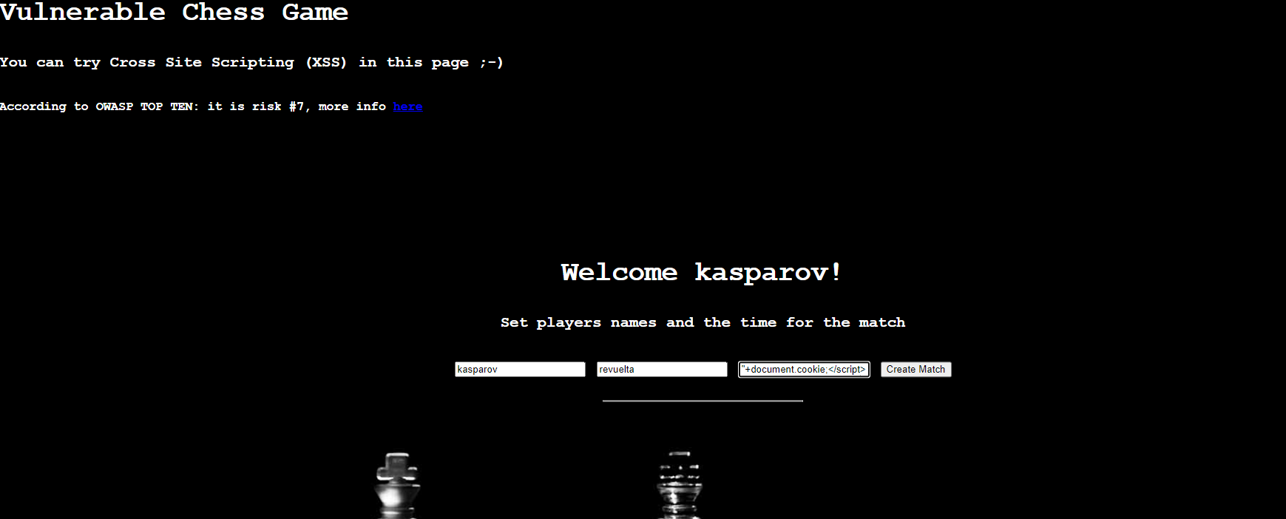
Cross site scripting

Slide 22
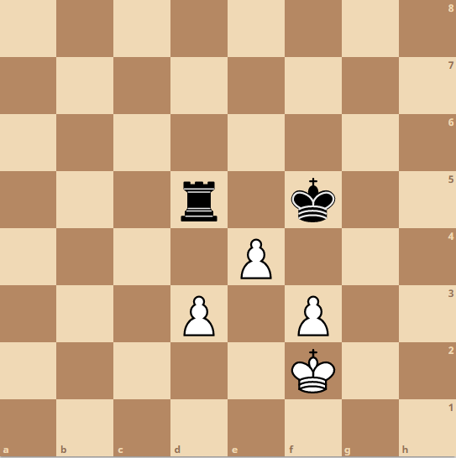
HTTP Response Splitting

Slide 23
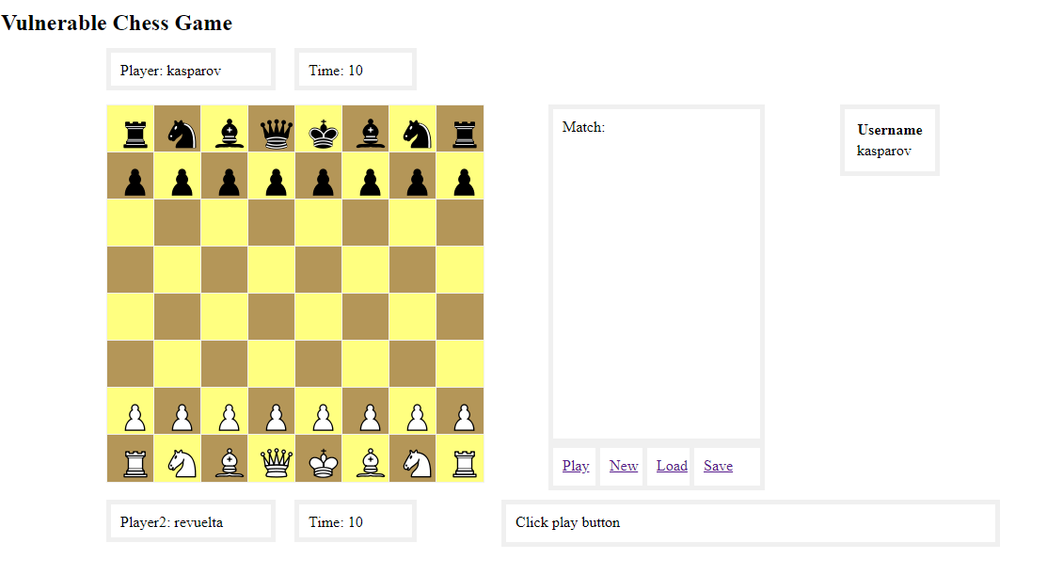
HTTP Response Splitting

Slide 24
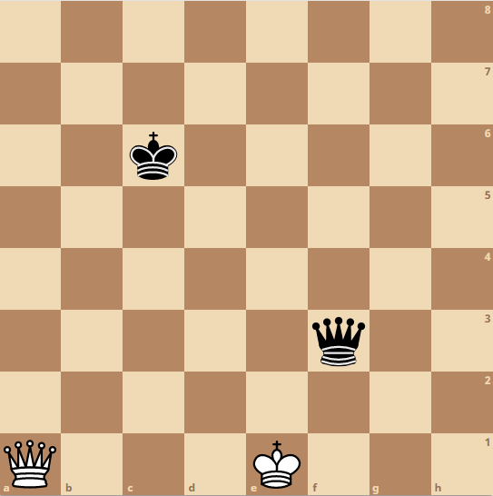
Path Traversal

Slide 25
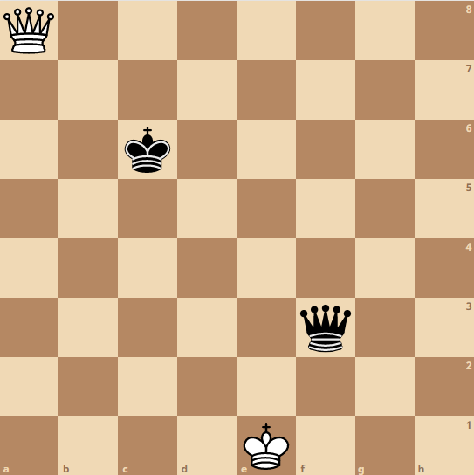
Path Traversal

Slide 26
Path Traversal

Slide 27
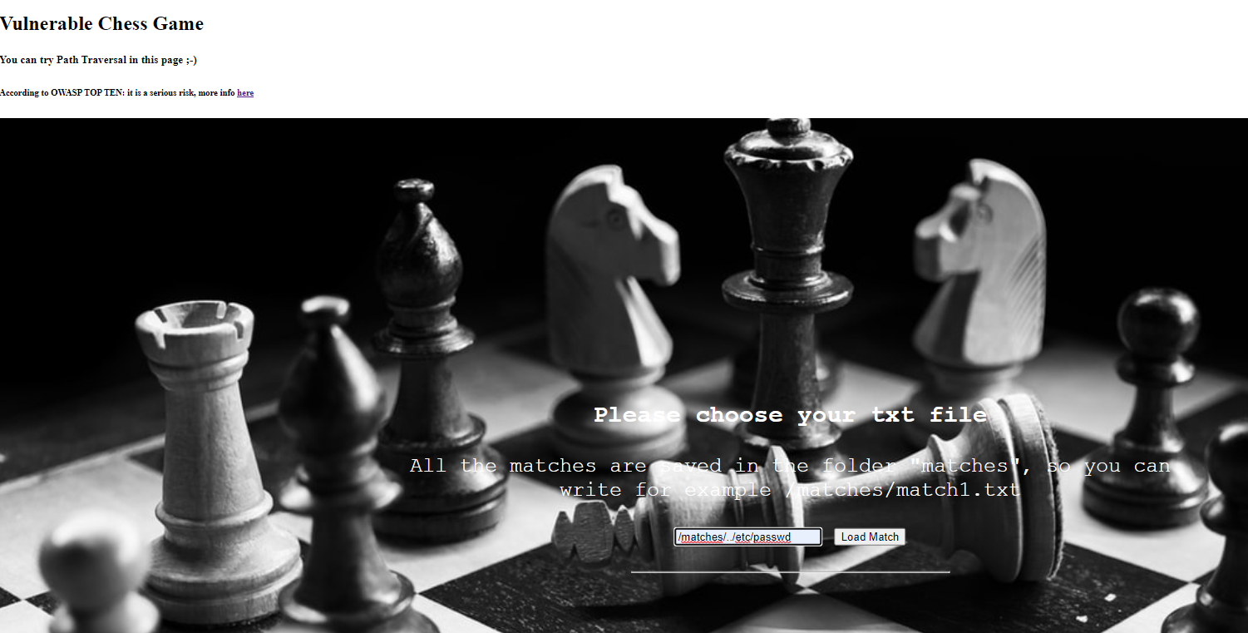
Path Traversal (Demo)

Slide 28
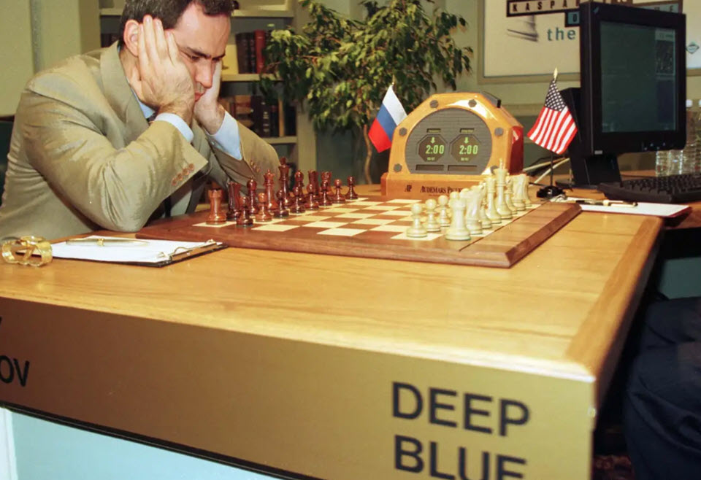
Deep code to win the match
Deep blue was the first machine to win a world chess champion as Kasparov (Nueva York 1997)
We need intelligence machine to win the match against vulnerabilities.

Slide 29
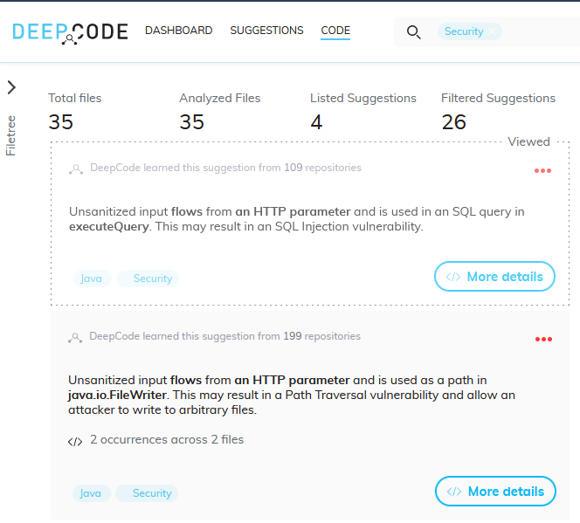
Deep code to win the match

Slide 30
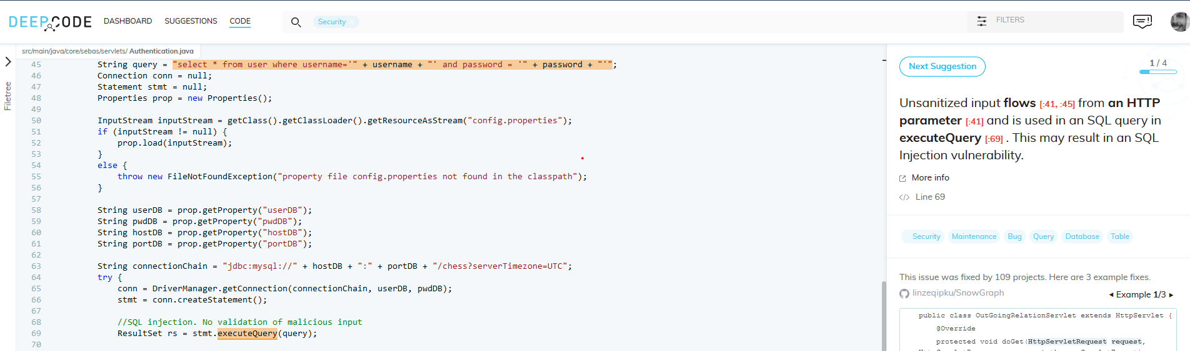
Deep code to win the match

Slide 31
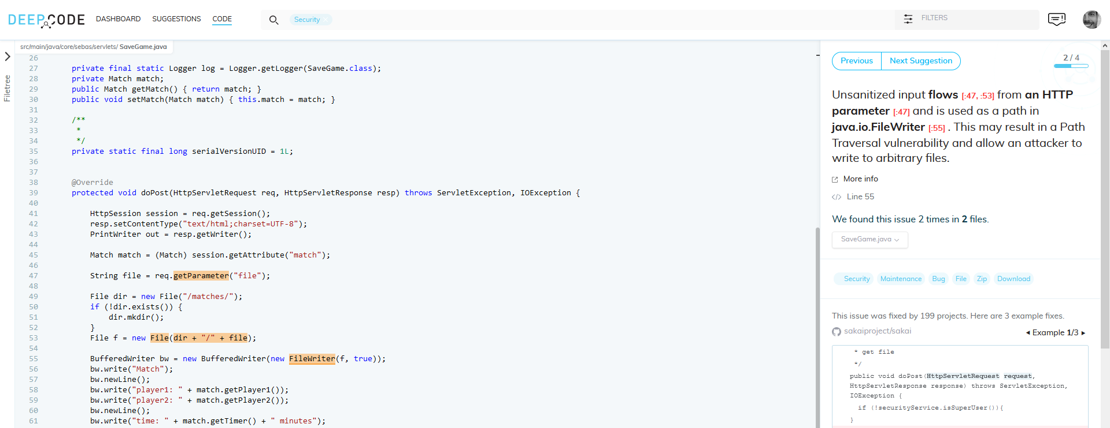
Deep code to win the match

Slide 32
Thanks ++
sebastianrevuelta@gmail.com
https://www.linkedin.com/in/sebasrevuelta/

